Slide 1
Linear Regression

Slide 2
Machine learning Algorithms
Unsupervised
Supervised
Clustering and Dimensionality reduction
SVD
PCA
K-Means
Hierarchical clustering
Association analysis
Apriori
FP-Growth
Hidden Markov model
Regression
Linear Regression
Polynomial Regression
Logistic regression
Random Forest
KNN
Naive Bayes
SVM

Slide 3
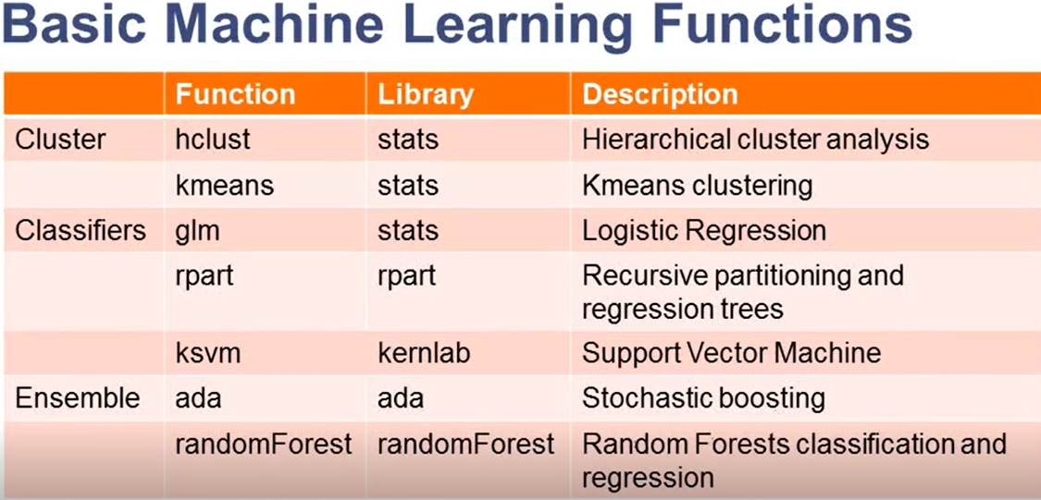

Slide 4
Regression Modelling

Slide 5
Regression techniques
Simple linear Regression
Multiple linear regression
Polynomial regression
Ridge regression
Lasso Regression
Logistic Regression

Slide 6
Simple linear Regression
Single Input variable
Single output variable
Example: Y = 2x +1

Slide 7
Multiple linear Regression
Multiple Input variables
Single output variable
Example: Y = 2x +3w+5t +4

Slide 8
Polynomial Regression
Multiple Input variables
Single output variable
Non linear relation
Example: Y = 3x²

Slide 9
Ridge and Lasso Regression
Correlated Input variables
Single output variable
Example: Y = 3X+2Z
Z = 2X

Slide 10
Logistic Regression
Multiple or single Input variables
Single output variable
Output: Yes/No; 1 or 0; IN or OUT

Slide 11
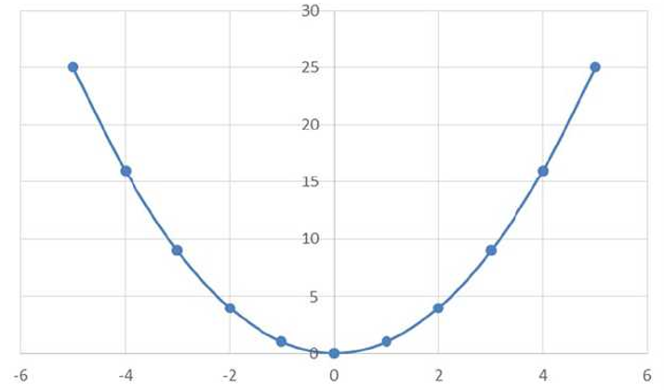
Correlation to Regression
X | Y
-31 | 900
-25 | 625
-24 | 576
-19 | 361
-13 | 169
-6 | 36
-1 | 1
3 | 9
10 | 100
11 | 121
14 | 196
15 | 225
24 | 576
29 | 841

Slide 12

Simple linear regression
X | y
1 | 2
2 | 3
3 | 3
4 | 5
5 | 7
6 | 7

Slide 13
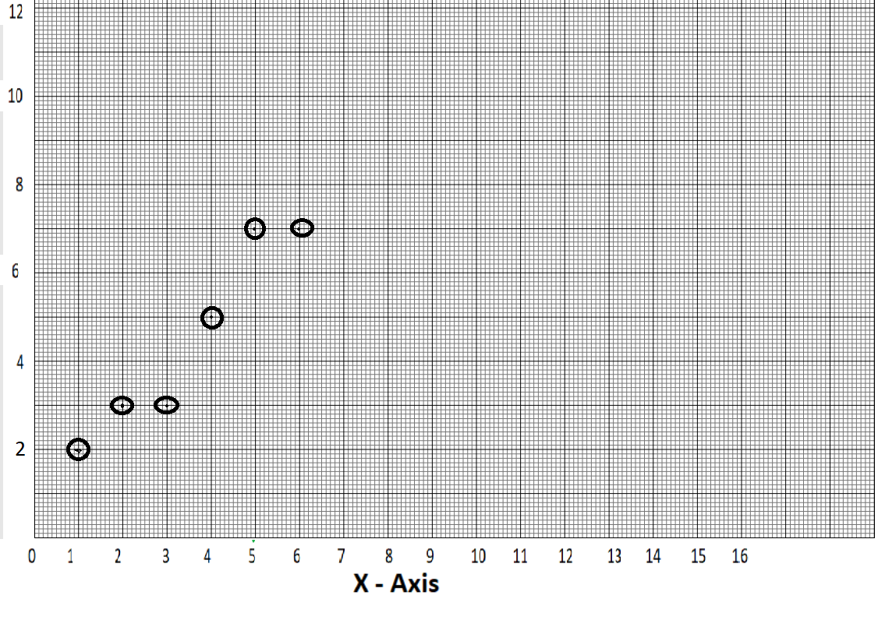
Simple linear regression
X | y
1 | 2
2 | 3
3 | 3
4 | 5
5 | 7
6 | 7

Slide 14
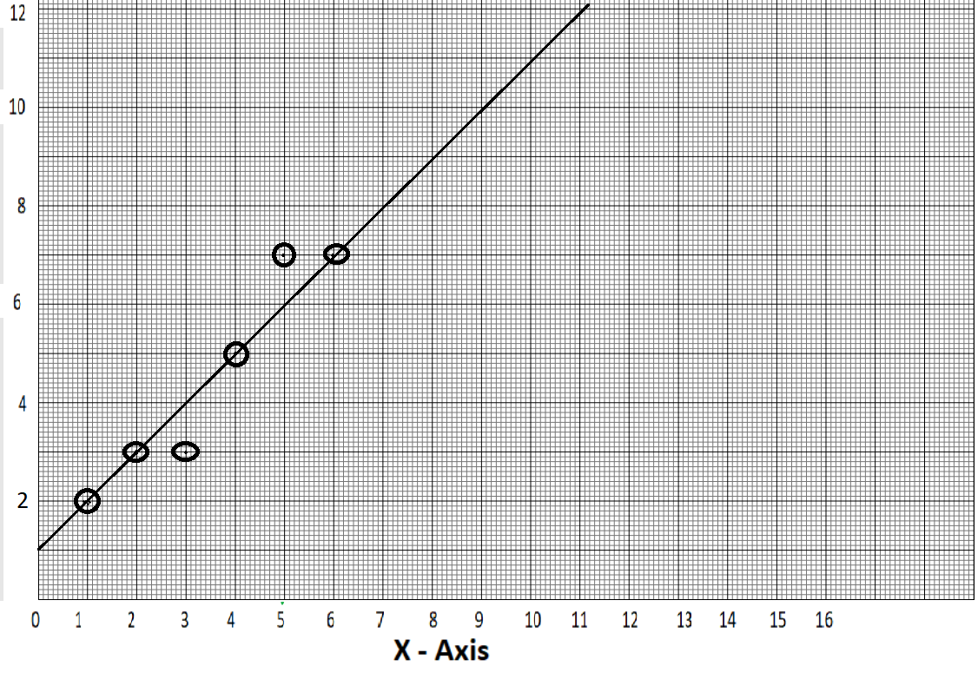
Simple linear regression
X | y
1 | 2
2 | 3
3 | 3
4 | 5
5 | 7
6 | 7
11

Slide 15
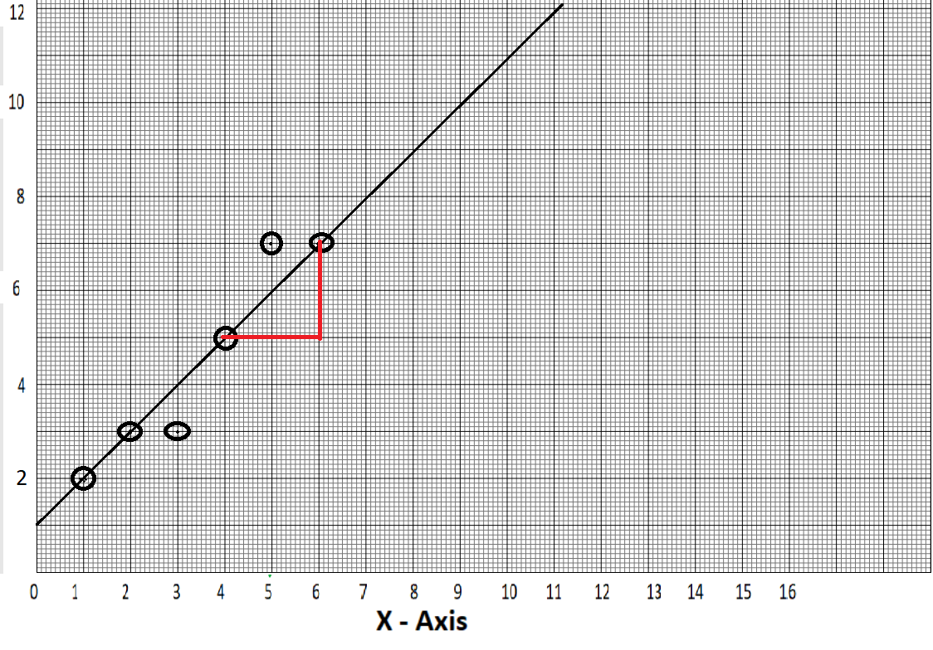
Simple linear regression
X | y
1 | 2
2 | 3
3 | 3
4 | 5
5 | 7
6 | 7
(x2,y2)
(6,7)
(x1,y1)
(4,5)
(Y2-Y1)
Slope = ------------
(X2-X1)
(0,1)
(7-6)
Slope = ------- = 1
(5-4)

Slide 16
Simple linear regression
X | y
1 | 2
2 | 3
3 | 3
4 | 5
5 | 7
6 | 7
Simple linear regression model
(x2,y2)
(6,7)
(x1,y1)
(4,5)
Y = slope*X + Intercept
(0,1)
Y = X + 1

Slide 17
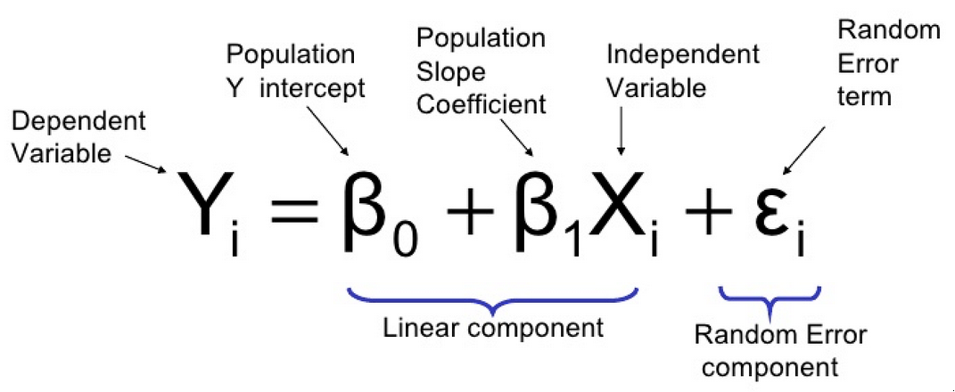
General Linear Regression equation

Slide 18
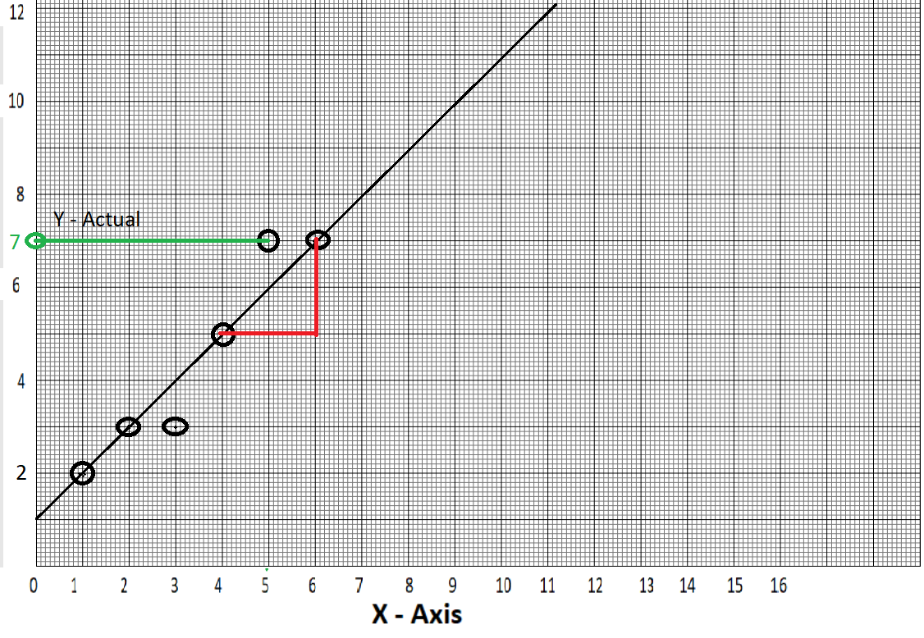

Slide 19
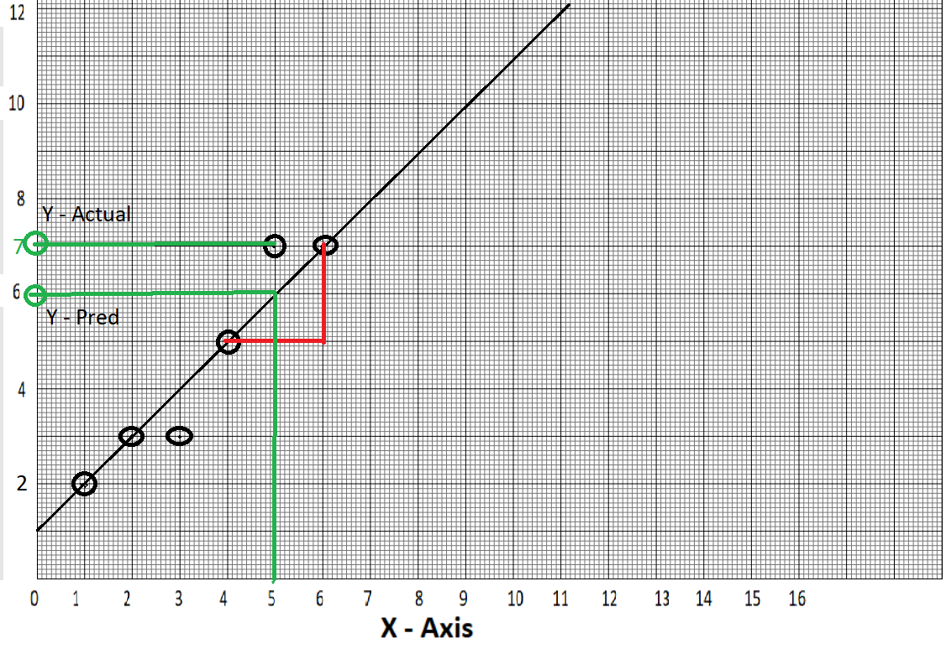

Slide 20
X | y | predicted y | e = y-predicted y
1 | 2 | 2 | 0
2 | 3 | 3 | 0
3 | 3 | 4 | -1
4 | 5 | 5 | 0
5 | 7 | 6 | 1
6 | 7 | 7 | 0
Sum = 0

Slide 21
X | y | predicted y | e = y-predicted y | e²
1 | 2 | 2 | 0 | 0
2 | 3 | 3 | 0 | 0
3 | 3 | 4 | -1 | 1
4 | 5 | 5 | 0 | 0
5 | 7 | 6 | 1 | 1
6 | 7 | 7 | 0 | 0
Overall squared error = 1² + 1² =2

Slide 22
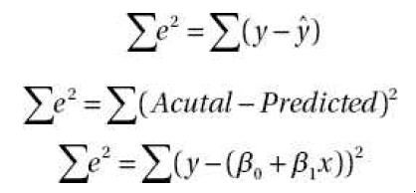

Ordinary least squares – Goodness of fit
Minimize it
The best fit line is the one with least SSE

Slide 23
How good is my Model?

Slide 24
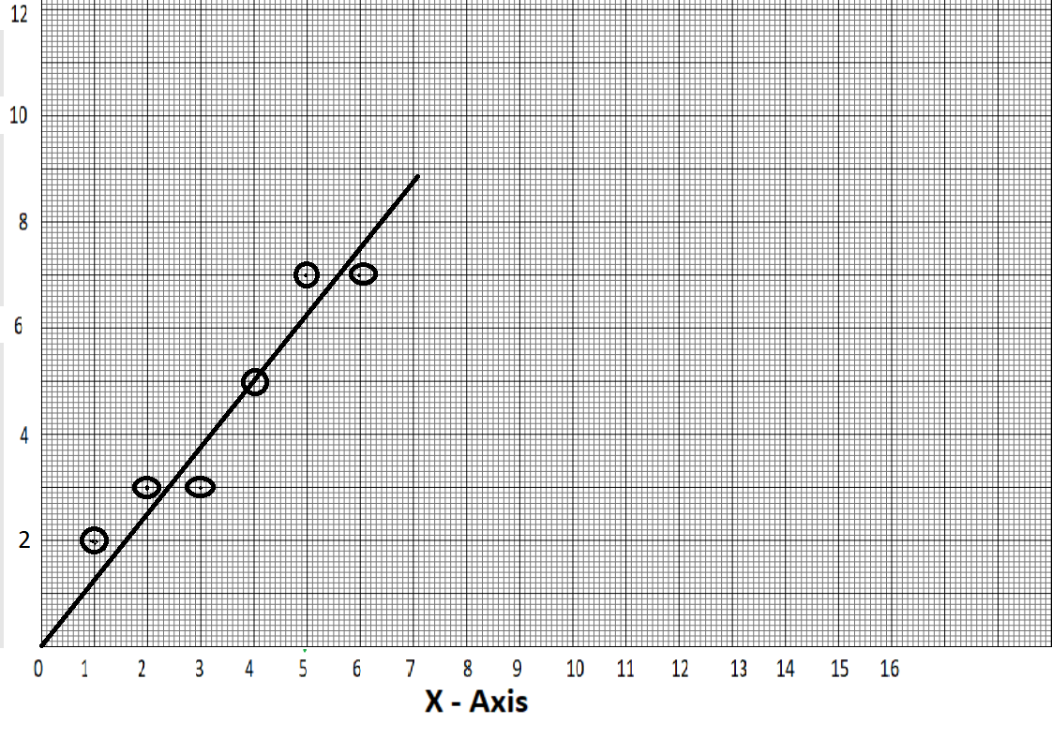
Simple linear regression
X | y
1 | 2
2 | 3
3 | 3
4 | 5
5 | 7
6 | 7
(x2,y2)
(6,7)
(x1,y1)
(4,5)
Y = slope*X + Intercept
(0,1)
Y = 1.2*X

Slide 25
X | y | predicted y | e = y-predicted y | e²
1 | 2 | 2 | 0.7 | 0.49
2 | 3 | 3 | 0.45 | 0.2025
3 | 3 | 4 | -0.8 | 0.64
4 | 5 | 5 | 0 | 0
5 | 7 | 6 | 0.7 | 0.49
6 | 7 | 7 | -0.4 | 0.16
SSE = 1.9825
What if SSE is in thousands??
SSE is not sufficient

Slide 26
X | y | predicted y | e = y-predicted y | e²
1 | 2 | 2 | 0.7 | 0.49
2 | 3 | 3 | 0.45 | 0.2025
3 | 3 | 4 | -0.8 | 0.64
4 | 5 | 5 | 0 | 0
5 | 7 | 6 | 0.7 | 0.49
6 | 7 | 7 | -0.4 | 0.16
Sum = 23.5
SSE = 1.9825
Mean(Y) = 4.5

Slide 27
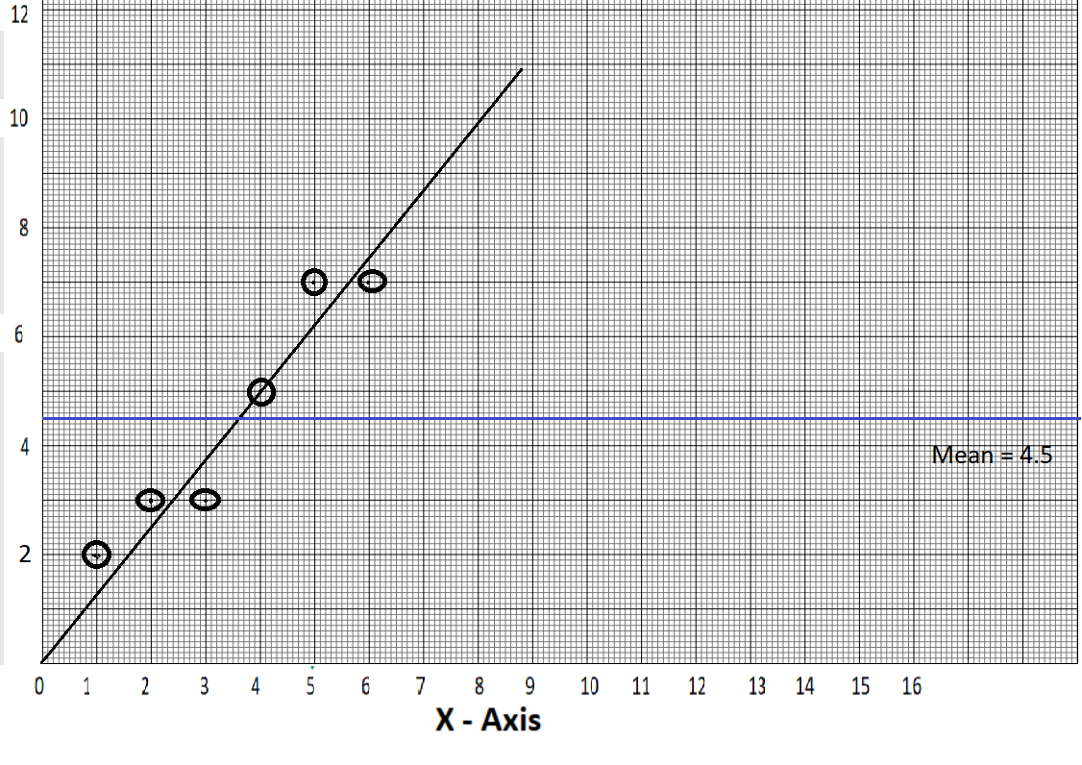

Slide 28
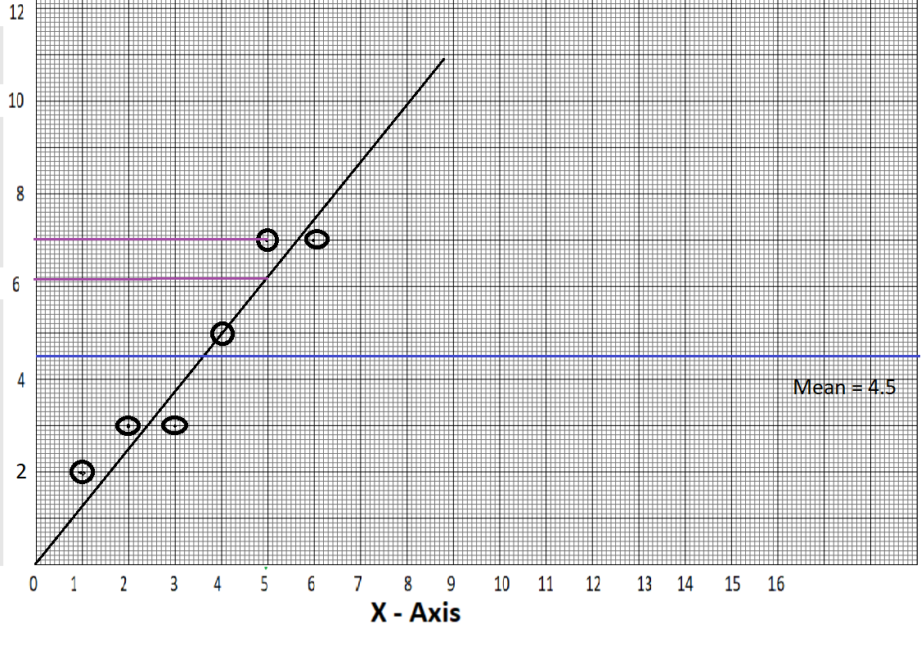
Use SST to calculate efficiency of model
SSE
Minimum for good model
SSE
SST
SSR
SST

Slide 29
X | y | predicted y | e = y-predicted y | Abs(e) | e²
1 | 2 | 1.3 | 0.7 | 0.7 | 0.49
2 | 3 | 2.55 | 0.45 | 0.45 | 0.2025
3 | 3 | 3.8 | -0.8 | 0.8 | 0.64
4 | 5 | 5 | 0 | 0 | 0
5 | 7 | 6.3 | 0.7 | 0.7 | 0.49
6 | 7 | 7.4 | -0.4 | 0.4 | 0.16
y-mean(y)
-2.5
-1.5
-1.5
0.5
2.5
2.5
Mean =4.5
Sum =3.05
SSE =1.9825

Slide 30
X | y | predicted y | e = y-predicted y
1 | 2 | 1.3 | 0.7
2 | 3 | 2.55 | 0.45
3 | 3 | 3.8 | -0.8
4 | 5 | 5 | 0
5 | 7 | 6.3 | 0.7
6 | 7 | 7.4 | -0.4
Abs(e)
0.7
0.45
0.8
0
0.7
0.4
e² | y-mean(y) | square(y-mean(y))
0.49 | -2.5 | 6.25
0.2025 | -1.5 | 2.25
0.64 | -1.5 | 2.25
0 | 0.5 | 0.25
0.49 | 2.5 | 6.25
0.16 | 2.5 | 6.25
Mean =4.5
Sum =3.05
SSE =1.9825
SST =23.5

Slide 31
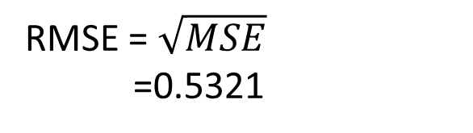
Model coefficients
1.9825
SSR
21.575
SSE
=
= 0.91563 → R-Squared
=
= 0.084362
SST
23.5
SST
23.5
SST = SSR + SSE
=> SSR = SST- SSE
MSE = SSE/n
= 1.9825/7
= 0.283214
RMSE = $\sqrt{MSE}$
=0.5321
= 23.5 – 1.9825
= 21.575
MAE = sum(Abs(e))/n
= 3.05/7
= 0.435

Slide 32
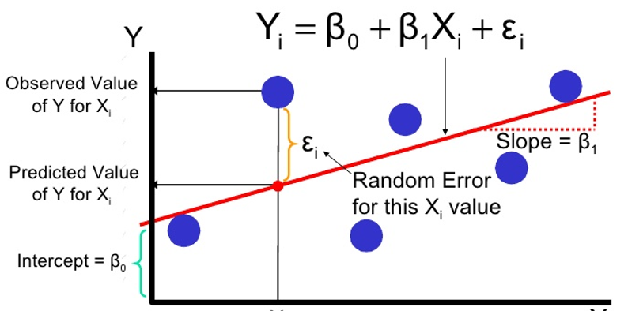
Assumptions of linear regression
X- Values (or the errors, “e”) are independent
Y-Values are dependent can be expressed as a linear function of X-Variable
Y = f(x)
Variation of observations around the regression line (residual SE) is constant – Homoscedasticity
For given X,Y (or error) is normally distributed

Slide 33
Multiple linear regression
X3
X3
X4
X5
X2
X1
Y
X6

Slide 34
Multiple linear regression equation
Y = β_{o}+ β₁x₁+ β₂x₂+ β₃x₃+ β₄x₄+ β₅x₅+ β₆x₆+…+β_{p}x_{p}
y = 3X1 + 6.5X2 - 0.3X3 +4

Slide 35
Assumptions of multiple linear regression
Y- Values (or the errors, “e”) are independent
Y-Values can be expressed as a linear function of X-Variable
Variation of observations around the regression line (residual SE) is constant – Homoscedasticity
Independent and dependent values (or errors) are normally distributed
No multicollinearity being present

Slide 36
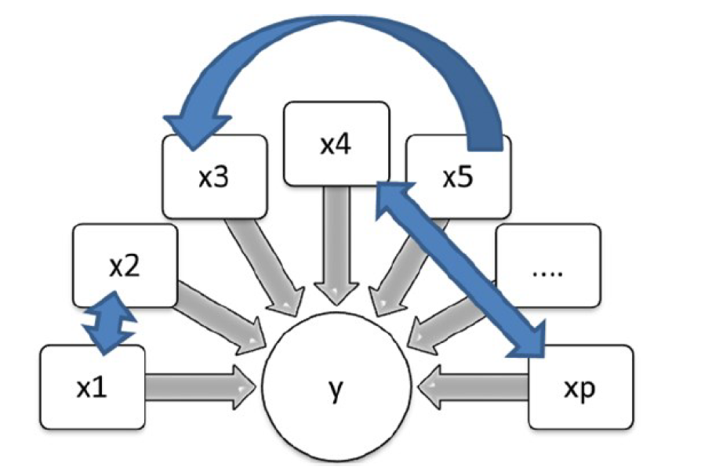
Multicollinearity

Slide 37
Effect of multicollinearity
and X3 ~ 2X2
Consider, Y=X1+20X2-2X3
Y=X1+ 14X2+6X2-2X3
=> Y ~ X1+14X2+ 3X3-2X3
=> Y ~ X1+14X2+ X3
(since X2=X3/2)

Slide 38
Next level questions…
What causes multicollinearity?
How do you identify the existence of multicollinearity in my model?
Once multicollinearity is identified, what is the way out? How can its effect be minimized?

Slide 39
What causes Multicollinearity
The way data was collected
Do not choose non associated variables while collecting the data
Too many variables explaining the same piece of information
Having too many independent variables and fewer records

Slide 40
How to identify multicollinearity?
Correlation helps partially
Not always as it is a pairwise association measure
Use VIF - Variance inflation factor.

Slide 41
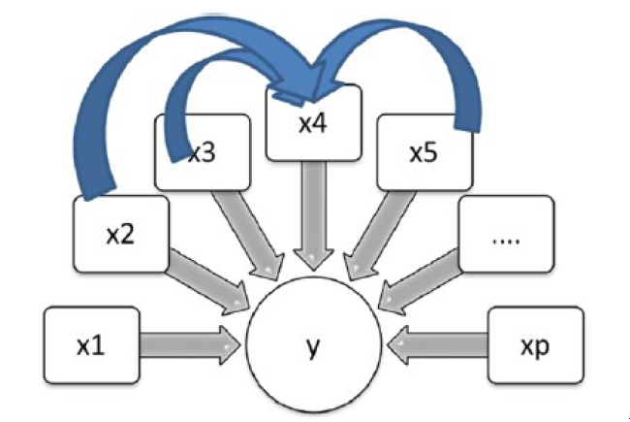
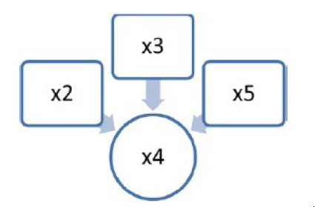
Determine R-squared value
x1 vs. x2, x3.......xp → R-squared value (R² 1)
x2 vs. x1, x3.......xp → R-squared value (R² 2)
...............................................................
xp vs. x1, x2, x3.......xp-1 → R-squared value (R² p)
If R² > 0.8
Multicollinearity
identified

Slide 42

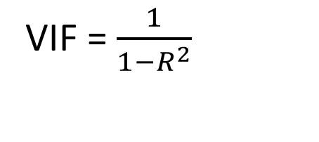
VIF - Variance Inflation factor
VIF = $\frac{1}{1−R^{2}}$

Slide 43
How to get out of it?
If VIF of a variable > 5, it indicates strong multicollinearity – Drop variable
Ridge regression is another way to treat the multicollinearity
Data transformation may yield good results sometimes
use principal component analysis (PCA) instead of variables.

Slide 44
Steps in multiple linear regression
Fit a model and check its F-Test P-value
If P-Value>0.05
If P-Value<0.05
Stop. Model is insignificant
Model is significant
Prepare data again
Use T-Test P-value for each variable for variable selection
Fit an improved model with selected variables

Slide 45


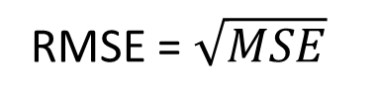
Goodness of fit
F-Test of the model
R-Squared
Mean squared error(MSE)
Root mean square error(RMSE)
Mean absolute error(MAE)
Adjusted-R Square
RMSE = $\sqrt{MSE}$

Slide 46
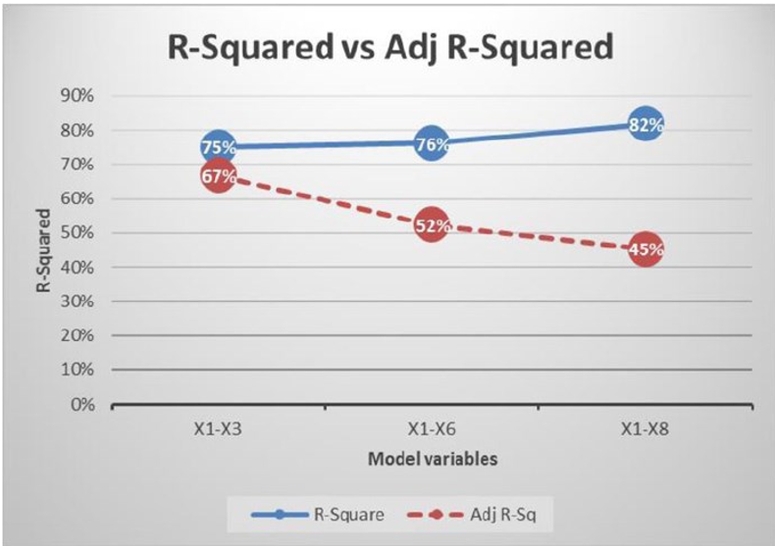
Over Fitted Model

Slide 47
What is over-fitting?
Phenomenon of developing a model by training it to learn all the noise in the dataset.

Slide 48
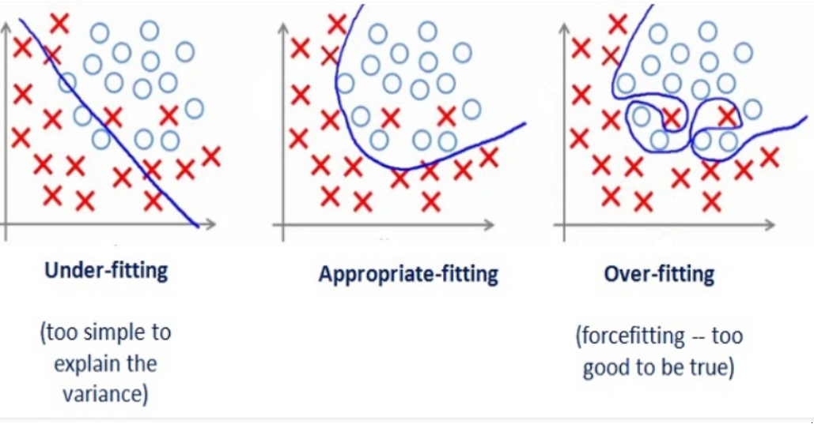

Slide 49
Fixing the deviations of assumptions
Linearity assumption – add a non-linear term like squared term
Heteroscedasticity – transform the existing variable – applying log to the variable
Normality of errors – log transformation of the variables

